Slide 1
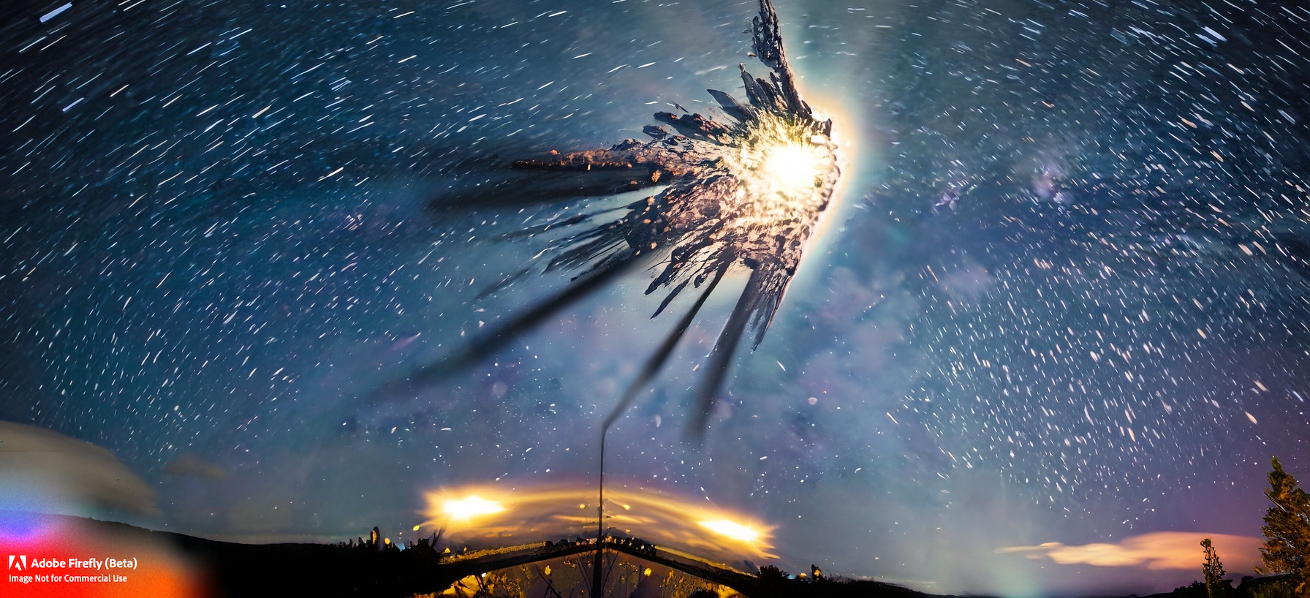
A Fantastic Imagination of Digital Disintegration:
The Gestalt and Rhetoric of the Atomization of the Social Network/Virtual World
Northern Star Symposium 2023: Disintegration | Nord University | Bodø, Norway
Andrew Phelps
Professor of Film & Media Arts, School of Communication
Professor of Computer Science, College of Arts & Sciences
Director, American University Game Lab
American University, Washington, DC
President, Higher Education Video Game Alliance
Mia Consalvo
Professor of Communication Studies
Canada Research Chair for Games Studies & Design
Founding Director, mLab
Concordia University
Notes:
Image generated by Adobe Firefly from prompt “Show me the disintegration of the North Star as seen from Norway"

Slide 2
What does ‘disintegration’ even mean?
We (maybe) started using this term in or around 1796 in reference to the field of geology, meaning ‘to separate in component parts, and by 1851 it is used in the transitive meaning ‘to break apart’.
In medicine, it generally refers to the dissolution of a solid dosage form into the body (i.e. dissolving a tablet or a pill)
In mathematics it refers almost exclusively to the formulation of the disintegration theorem (which I won’t even try to explain)

Slide 3
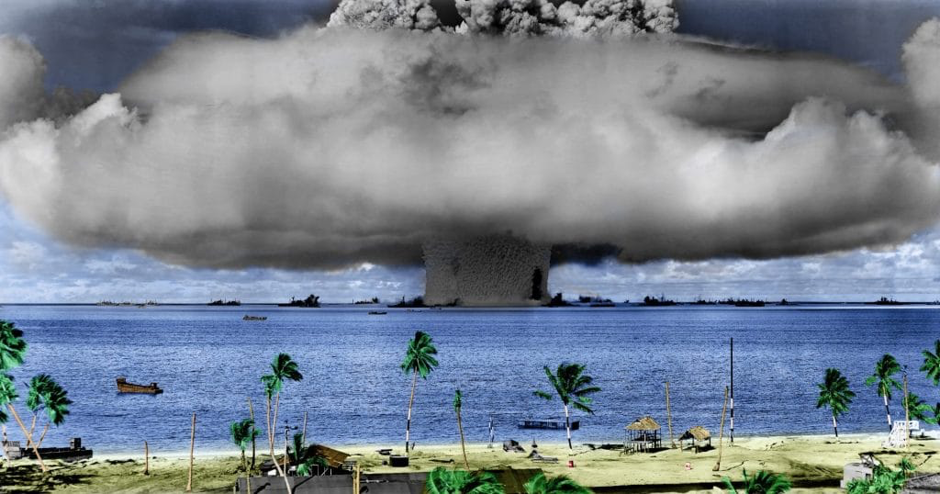
But then along comes the Cold War
This more than any other event seemed to cement the concept of disintegration (rightly or wrongly) in the public eye?
There is a technical meaning to it related to nuclear half-life, which is “the time interval required for the number of disintegrations per second of a radioactive material to decrease by one-half”
Source: https://www.britannica.com/science/half-life-radioactivity
Notes:
Image from https://thebulletin.org/2021/03/after-75-years-its-time-to-clean-bikini/ noted as “A nuclear weapon test by the US military at Bikini Atoll in 1946. (Credit: US Defense Department image via Wikimedia Commons, licensed with PD-USGov-Military)”

Slide 4
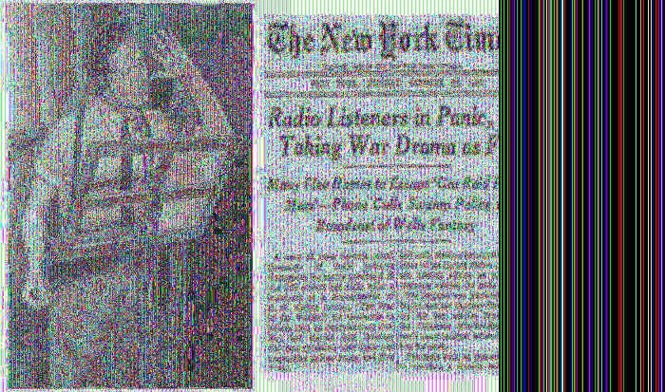
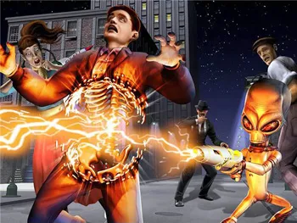
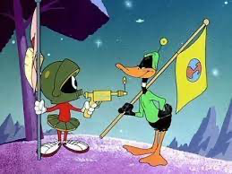
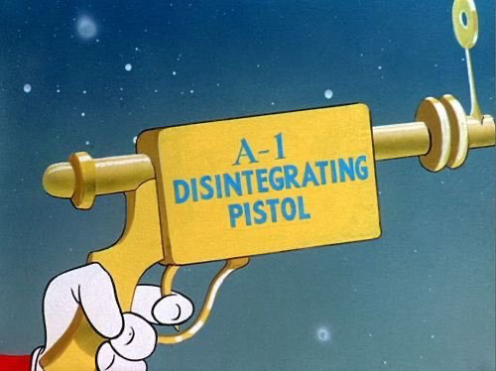
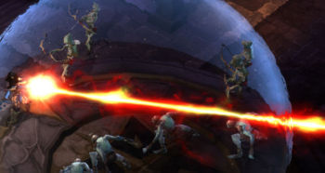
And before and after this, the effects of this on popular media…
Notes:
Images from
1) https://www.onthisday.com/articles/panic-over-war-of-the-worlds
2) https://static.tvtropes.org/pmwiki/pub/images/disintegrator-ray_destroy-all-humans_4523.jpg
3) https://cults3d.com/en/3d-model/art/m-martian-disintegration-pistol
4) https://i.etsystatic.com/13877451/r/il/4fc42c/1096255540/il_570xN.1096255540_rhmc.jpg
5) https://www.diablowiki.net/Disintegrate

Slide 5
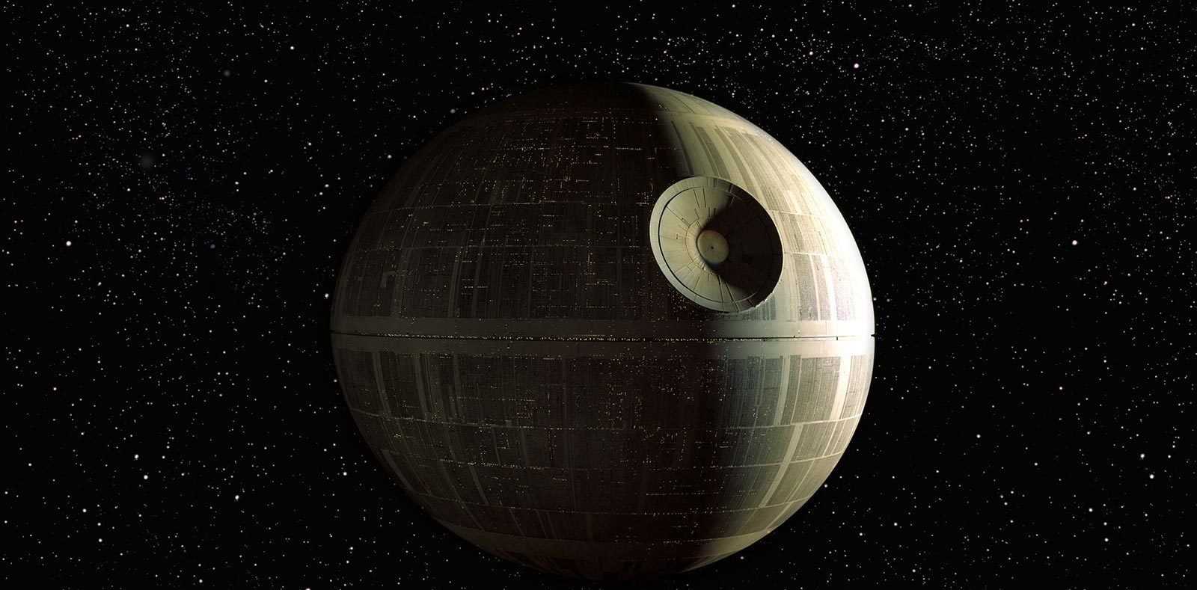
Notes:
Image from https://www.starwars.com/databank/death-star

Slide 6
But this ISN’T how things actually break down in the real world… basically ever.
And yet we know from game scholars such as Pearce (2009), Poor and Skoric (2014), and others (Ducheneaut et al, 2007; Bruckman et al, 2002) that the destruction and dissolution of various platforms give rise to communities that have historically 1) migrated to other platforms or contexts for communication and engagement outside of the original gaming context, 2) documented their prior activities through posts and media in other locales either locally or using other media platforms, 3) re-created portions of these networks in other games or virtual worlds, or even 4) created locally run versions of the games to continue to engage with the worlds on their own terms and rules (Crenshaw and Nardi, 2016).

Slide 7
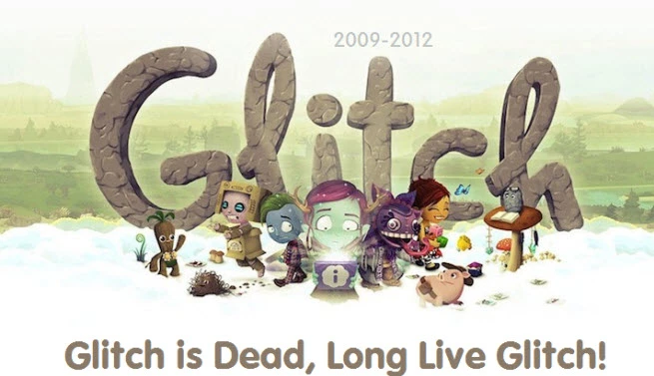
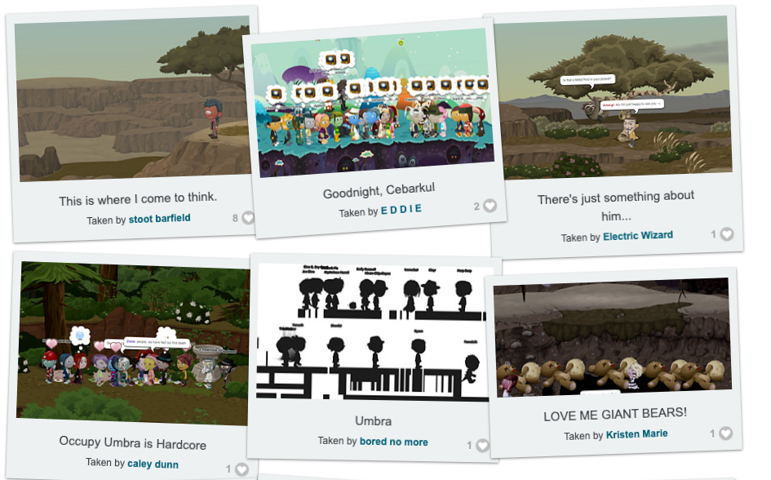
In the last days before Glitch shut down in 2012, the “Forehorsemen appeared on various streets, crying out ‘the end is neigh’” and on the game’s last day, “a server message rolled onto IM windows, saying “we really, really love you”” and the song “Goodnight Groddle closed the game” (Blackwell, 2012). Yet in Glitch just as with other virtual worlds that have closed, such events were marked by players gathering together, socializing, and planning how to meet up in other places after the servers finally ceased operating (Consalvo and Begy, 2015).

Slide 8
And even on Twitter…
More recently, Twitter, instead of disintegrating, has at best seen some user migration to Mastodon (Huang, 2022) and Hive (Perez, 2022), rather than a nuclear decay, even as it inexorably becomes a worse and worse platform (Doctorow, 2023). (Additionally, there is the issue of whether large numbers of users actually leave, or whether this is an empty threat in the first place. (Bogost, 2022)) In practice, as has happened before, the actual occurrences of social network disintegration (as viewed in more scientific terms), are very few and far between, while more mundane but less spectacular failure happens quite often.

Slide 9
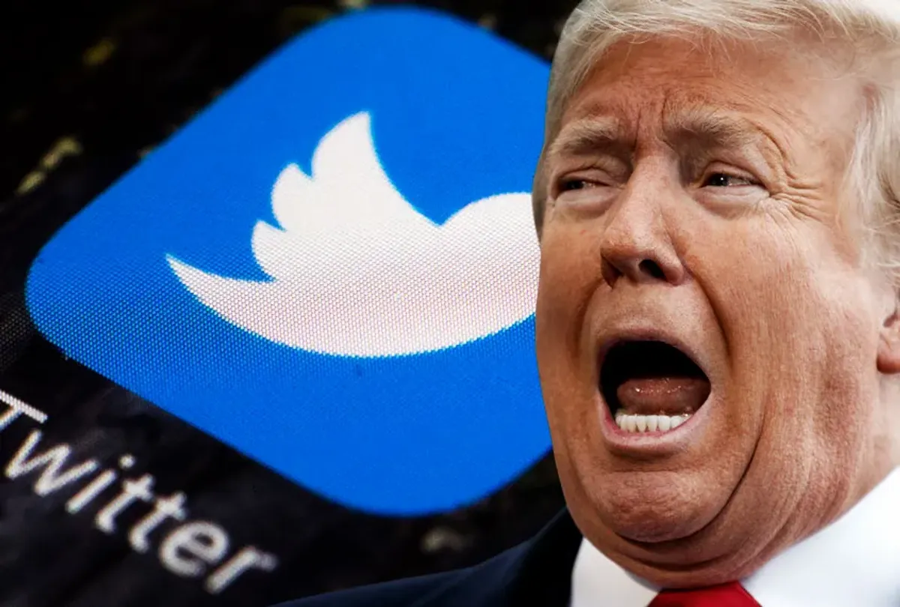
And even ‘intra platform’ things can die and be reborn.
On an individual scale, instances of “deplatforming” or “canceling” those who post objectionable, false, or malicious content can be seen as a similar effort to engage in a historical form of disintegration: damnatio memoriae, the “Roman practice of condemning the public memory of particularly traitorous, unfit, or unpopular leaders” by removing them from the historical record (Renzulli, 2020). But such efforts are unlikely to remove all traces, as such actions usually call attention to themselves, and future individuals can seek to restore those who fell out of favor. (As has been playing out in American politics surrounding Elon Musk’s restoration of Donald Trump’s Twitter account (Veiga, 2022)).

Slide 10
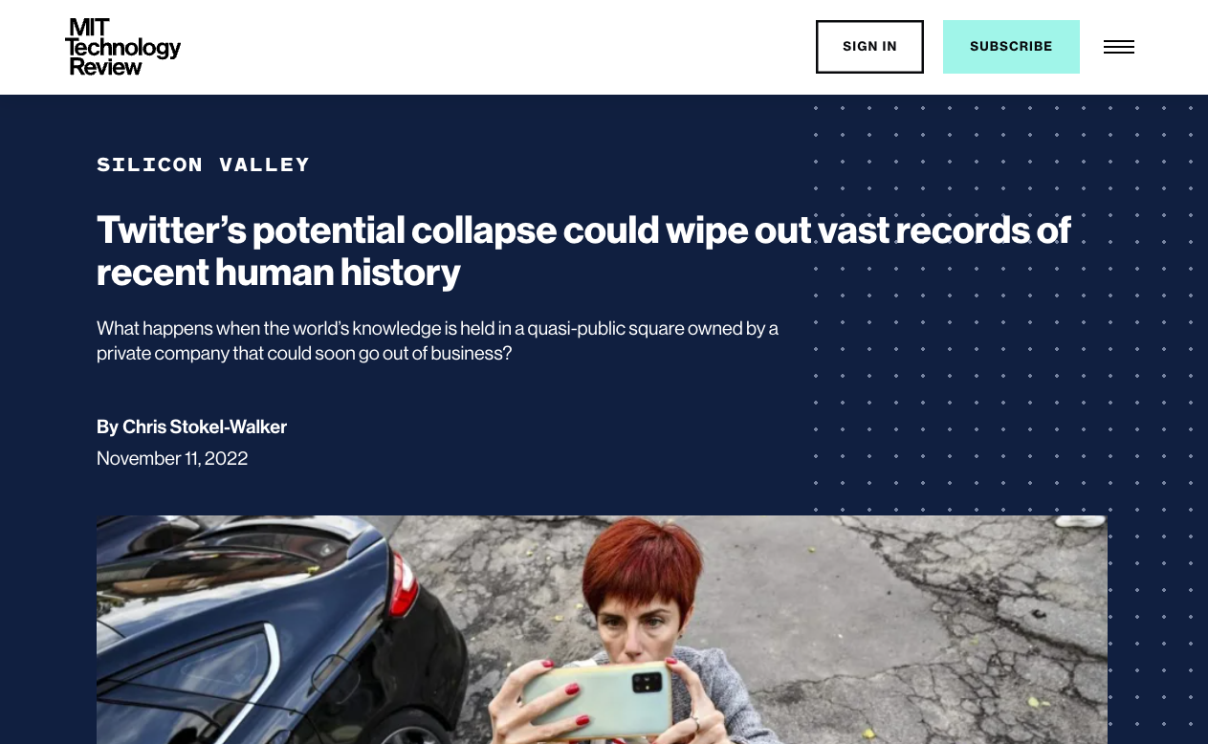
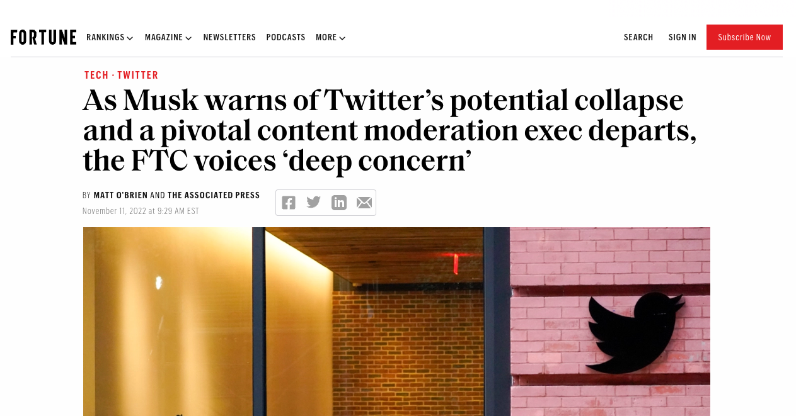
Yet the public rhetoric is almost always one of complete disintegration…

Slide 11
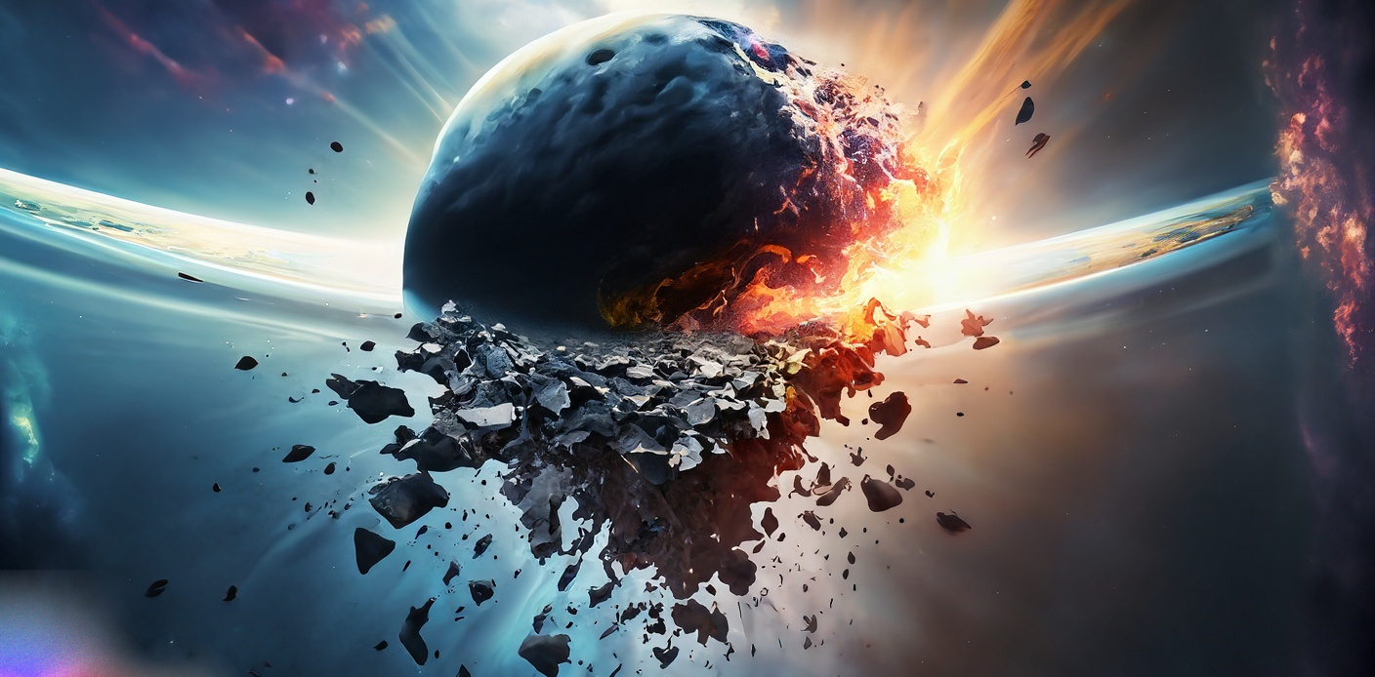
CONCLUSION (?)
…thus we surmise that the idea and form of disintegration, rooted in our ideas of dissolution, and reinforced as it is by both the layperson (mis)understanding of scientific concepts coupled with fantastical elements as depicted through popular media such as films, television, and games, inexorably binds our thinking on such topics to a gestalt of destruction in which only empty space remains, as if there were nothing but memories of what was there.
Notes:
“disintegration of the universe” as rendered by Adobe Firefly

Slide 12
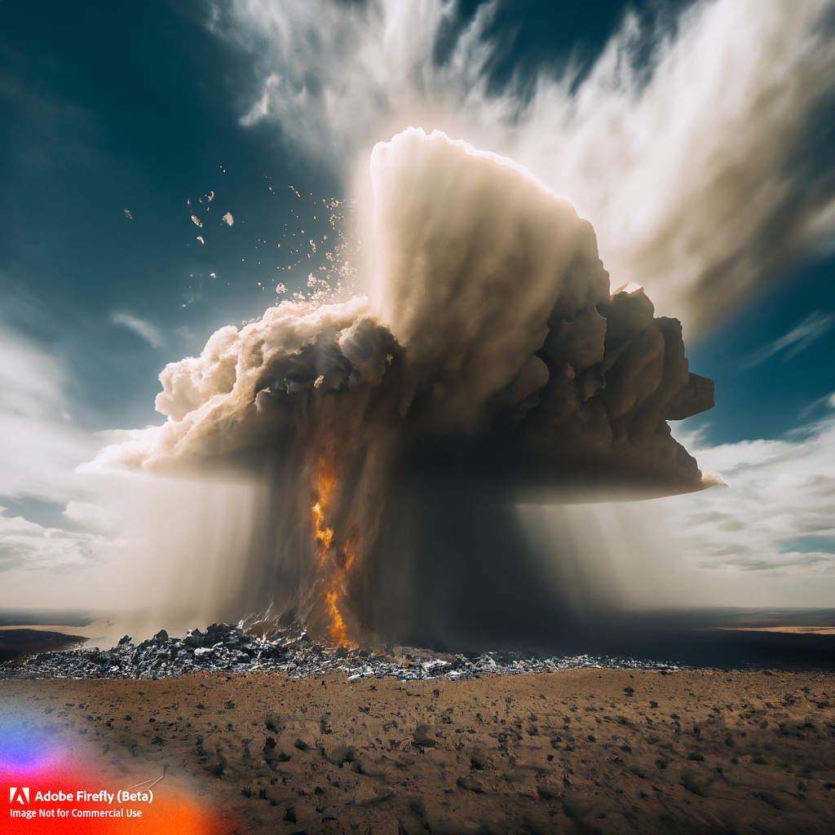
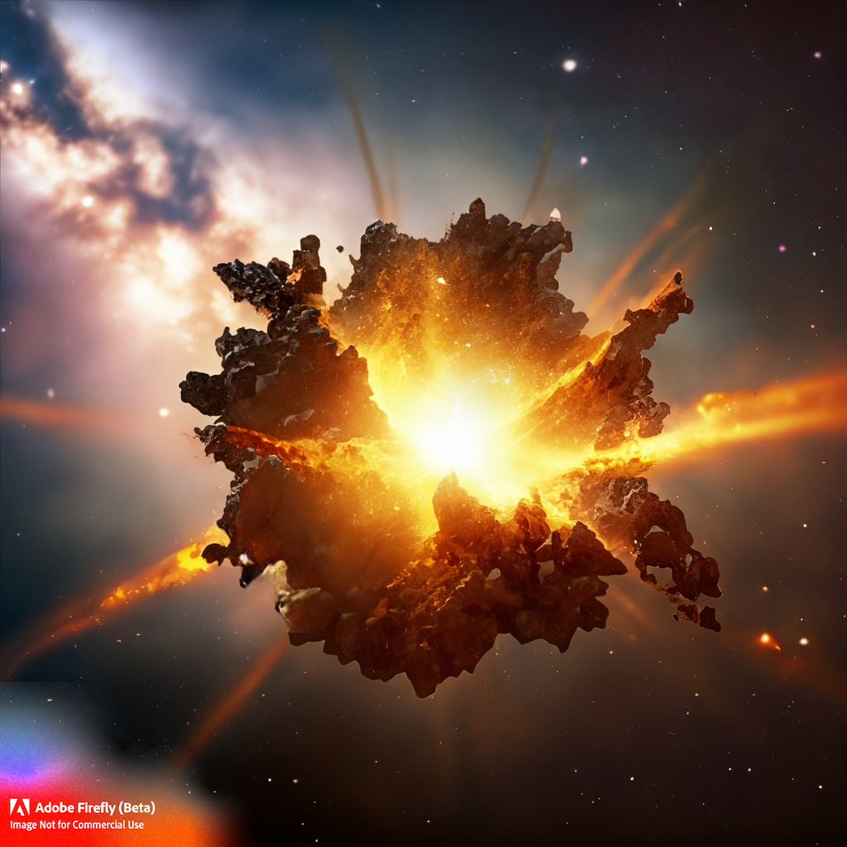
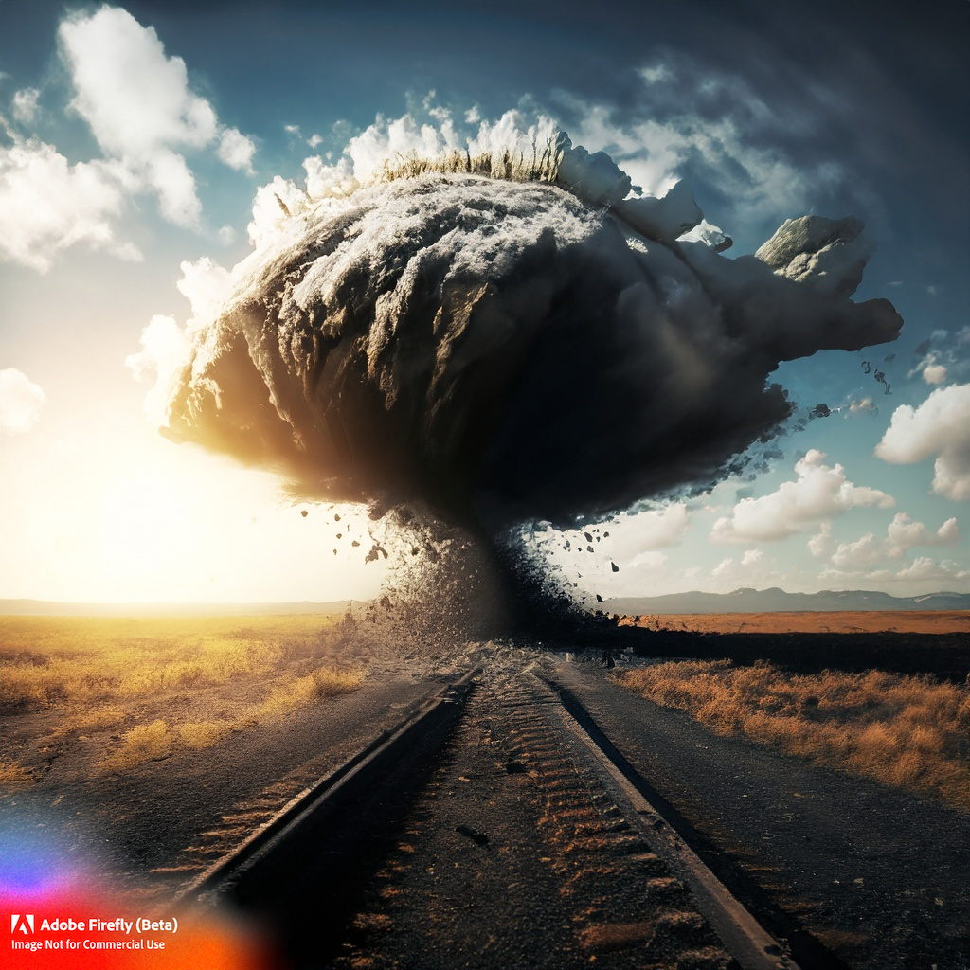
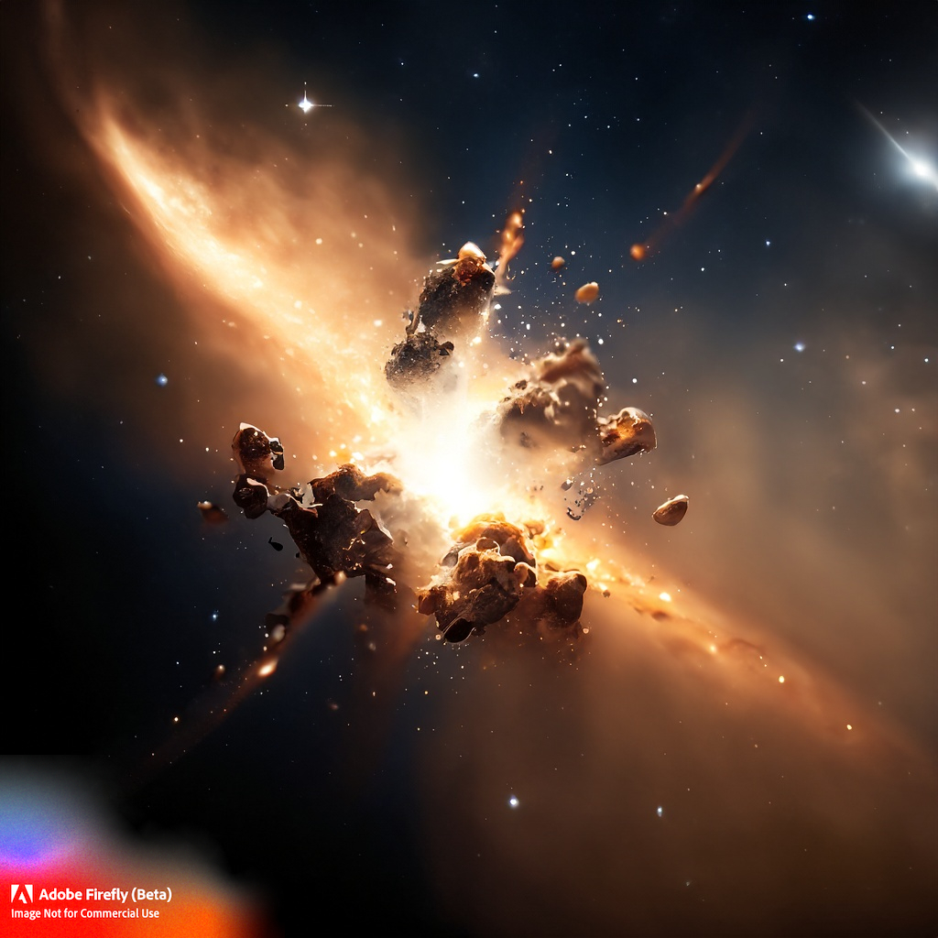
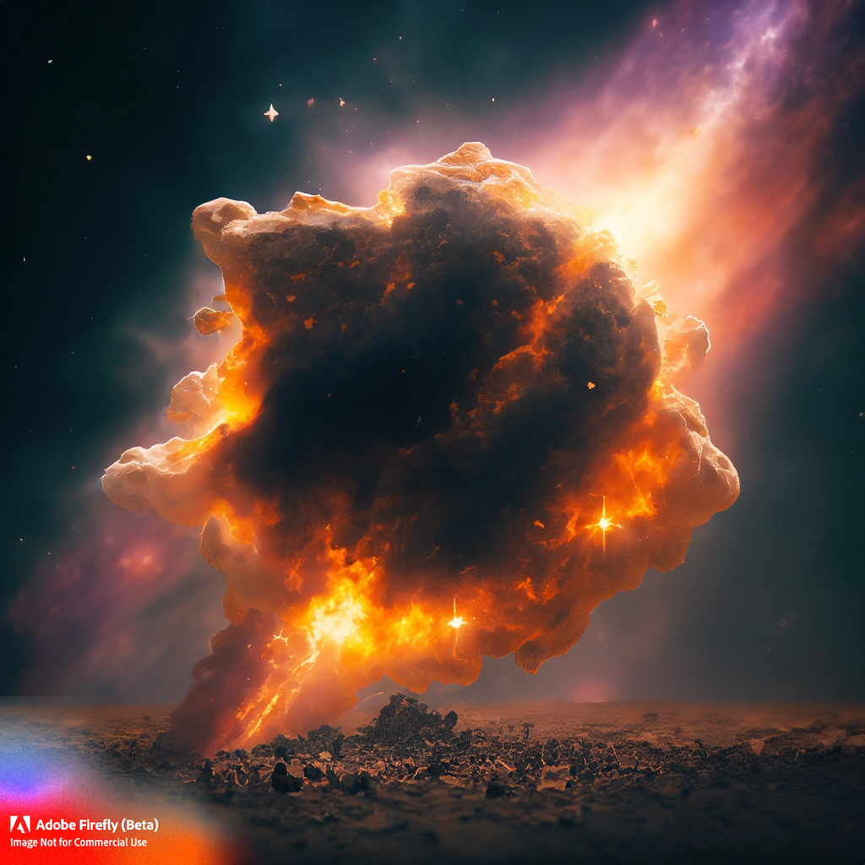
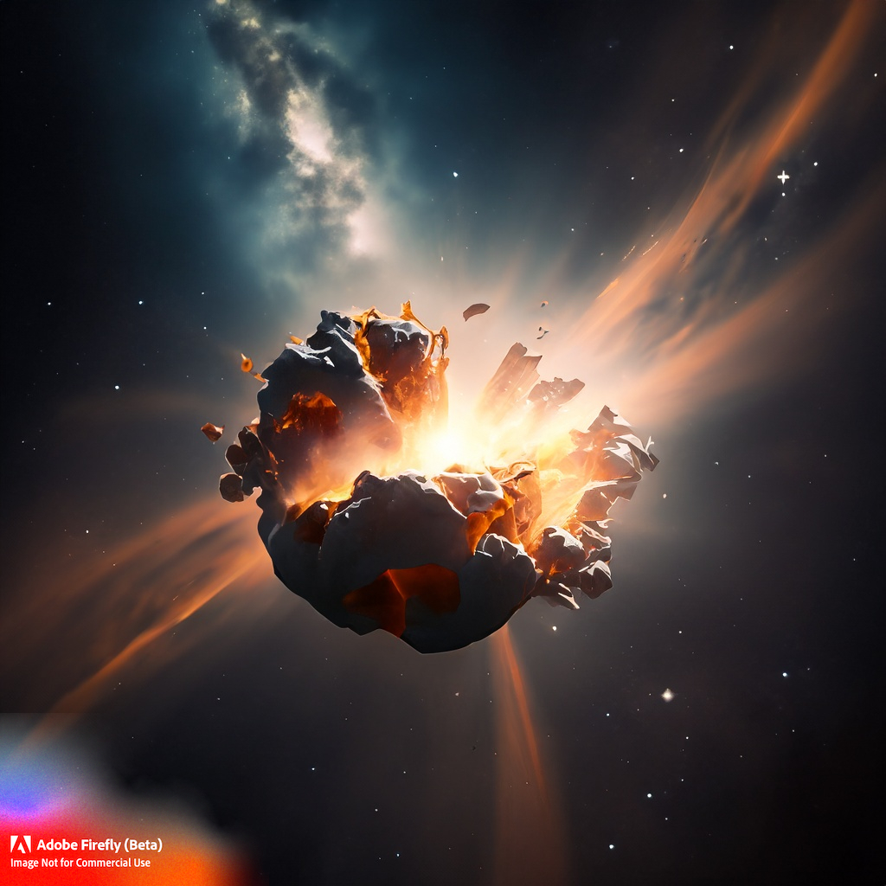
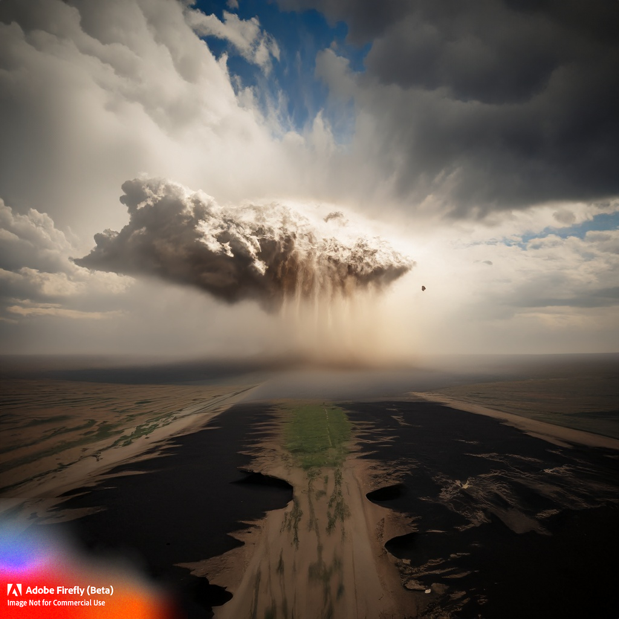
Notes:
Show me disintegration of the sky, show me disintegration of the stars. Adobe Firefly AI generated imagery.

Slide 13
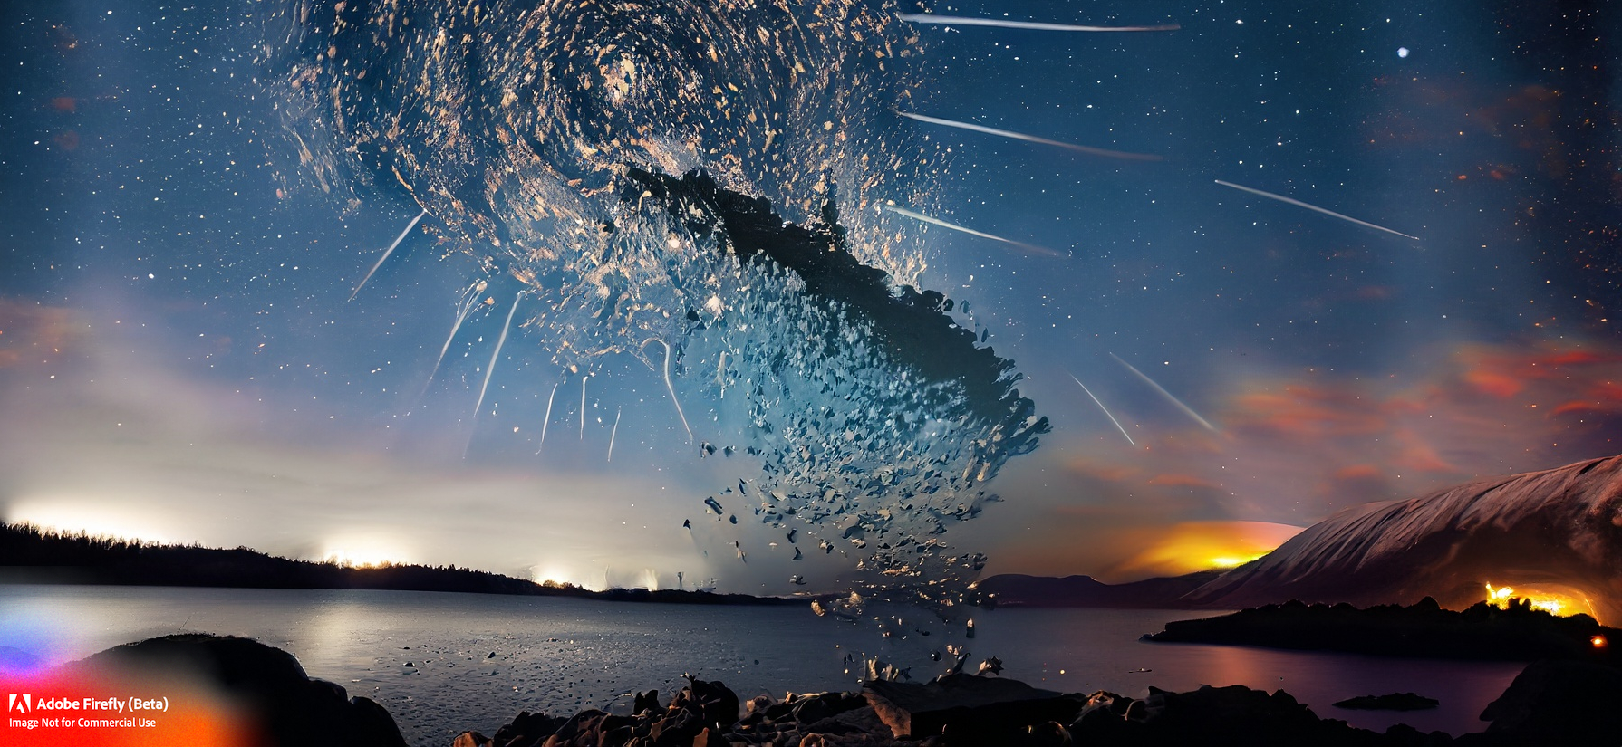
THANKS & QUESTIONS
ANDY
@andymphelps
andymphelps -at- gmail.com
andyworld.io
MIA
mconsalvo -at- gmail.com
miaconsalvo.com
Notes:
Image generated by Adobe Firefly from prompt “Show me the disintegration of the North Star as seen from Norway"

