Slide 1
EXISTENTIAL GAME DESIGN
Towards a Theory of Transformative, Existential Game Design
ANDY PHELPS
PROFESSOR, ARTIST, & DESIGNER • UNIVERSITY of CANTERBURY
(and) AMERICAN UNIVERSITY
4 AUGUST - 6 AUGUST
E: andymphelps@gmail.com L: linked.in/andymphelps T: @andymphelps
Notes:
Talk Title Card Slide. Add in your name and social media handle into the space in the bottom right corner. Copy over this slide into your own presentation!

Slide 2
HI, I’m ANDY

Slide 3
I make things.

Slide 4
This is work between myself and Dr. Doris Rusch at the Transformative Play Initiative at Uppsala University in Sweden: https://www.speldesign.uu.se/research/games-and-society-lab/transformative-play/
This work is also supported by the Applied Immersive Gaming Initiative (AIGI) at HITLabNZ at the University of Canterbury

Slide 5
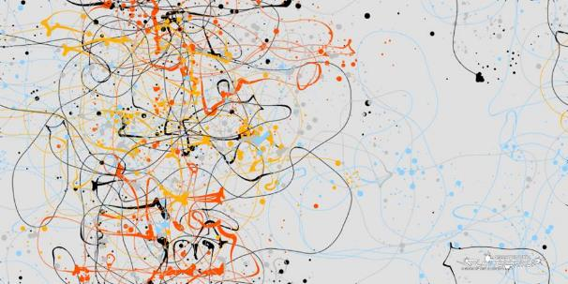
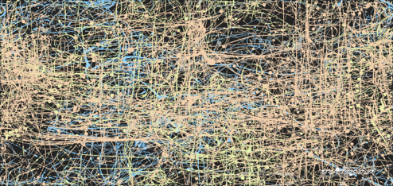

Slide 6
4 AUGUST - 6 AUGUST
Notes:
Content Slide. Add in your name and social media handle into the space in the bottom right corner.
Copy over this slide into your own presentation!

Slide 7
The Transformational Framework
(Sabrina Culyba, 2018)
intention is to change the player
in particular ways
change transfers to real life and lasts
4 AUGUST - 6 AUGUST
Notes:
Content Slide. Add in your name and social media handle into the space in the bottom right corner.
Copy over this slide into your own presentation!

Slide 8
“the kinds of change we can clearly measure are not all that interesting.”
–Paolo Pedercini, Games 4 Change keynote, 2014

Slide 9
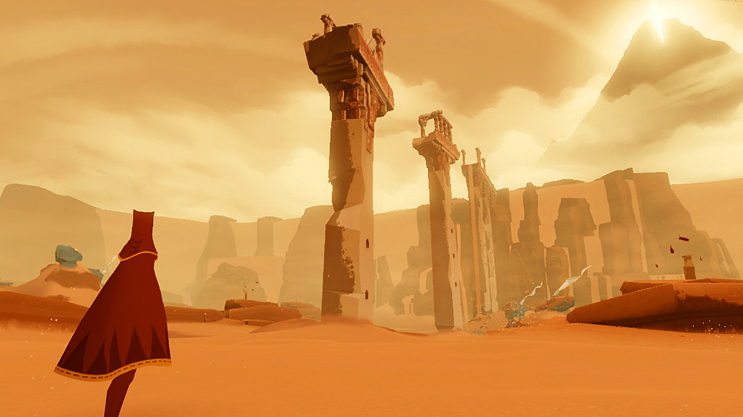
games can contribute to a meaningful life?
Notes:
Beyond measurable change…

Slide 10
EXISTENTIAL HUMANISTIC PSYCHOTHERAPY
rejects ideas of “mental illness” and focuses on creating a sense of true self, deep connection, purpose
client vs. patient
client is met where they are at, not with assumptions about who they are supposed to be
4 AUGUST - 6 AUGUST
Notes:
Content Slide. Add in your name and social media handle into the space in the bottom right corner.
Copy over this slide into your own presentation!

Slide 11
NOTES FOR GAME DESIGN
transformational design approach that doesn’t try to change player
player is not assumed to need fixing
game aims to provide possibility space to explore and contemplate the game’s existential themes and see what resonates with players out of their own accord
4 AUGUST - 6 AUGUST
Notes:
Content Slide. Add in your name and social media handle into the space in the bottom right corner.
Copy over this slide into your own presentation!

Slide 12
Enter the Unknown Forest
“A myth is a way of making sense in a senseless world.
Myths are narrative patterns that give significance to our existence.” (Rollo May, 1991)
Notes:
key figures of existential psych. turned to myth to deal with the baffling question of meaninglessness. Rollo May: “The Cry for Myth”. When science fails, we turn to art.

Slide 13
MYTHS WORK THROUGH RESONANCE
Jung: “the auditor experiences some of the sensations but is not transformed. Their imaginations are stimulated: they go home and through personal fantasies begin the process of transformation for themselves. (Bonnett, 2006)
4 AUGUST - 6 AUGUST
Notes:
Content Slide. Add in your name and social media handle into the space in the bottom right corner.
Copy over this slide into your own presentation!

Slide 14
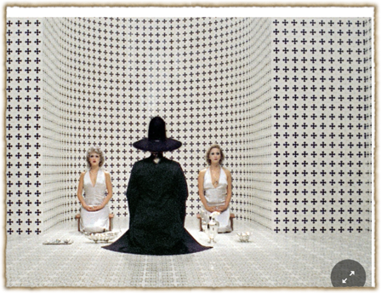
RITUAL IS ENACTED MYTH
Transformative potential of symbolic action
Getting a handle on “inner processes” through performance of symbolic actions
Jodorowski: “psychomagic, poetic acts”
Game Mechanics as symbolic enactments of inner processes
4 AUGUST - 6 AUGUST
Notes:
Content Slide. Add in your name and social media handle into the space in the bottom right corner.
Copy over this slide into your own presentation!

Slide 15
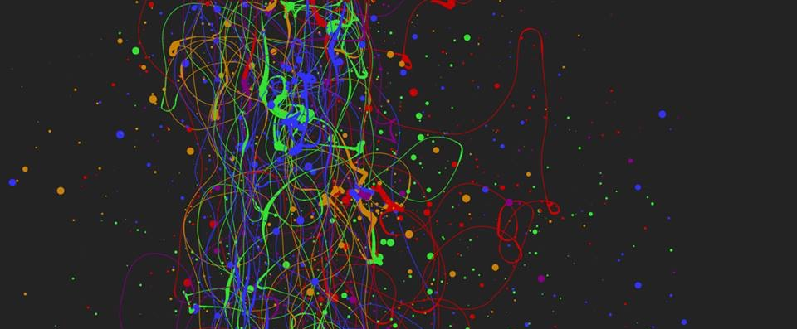
EXPERIENTIAL GAMES – “WHAT YOU PLAY IS WHAT YOU GET”
When we refer to experiential design, we mean the entire contextual experience of playing a game, and the interpretation of the experience by the player directly in the context of the experience itself. This kind of ‘what you do is what you get’ game is of increasing interest in the field, and in this manner is essentially an ‘experientially educational’ game (Phelps, Wagner, and Moger, 2020).
Players can gain an understanding of, and empathy for, a given scenario or subject matter merely through the act of playing it, and specifically through the act of interacting with it. (Phelps, 2020)

Slide 16
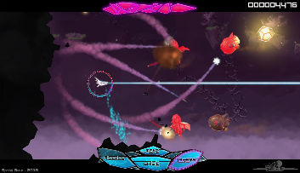
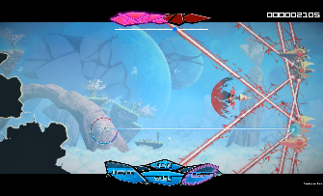
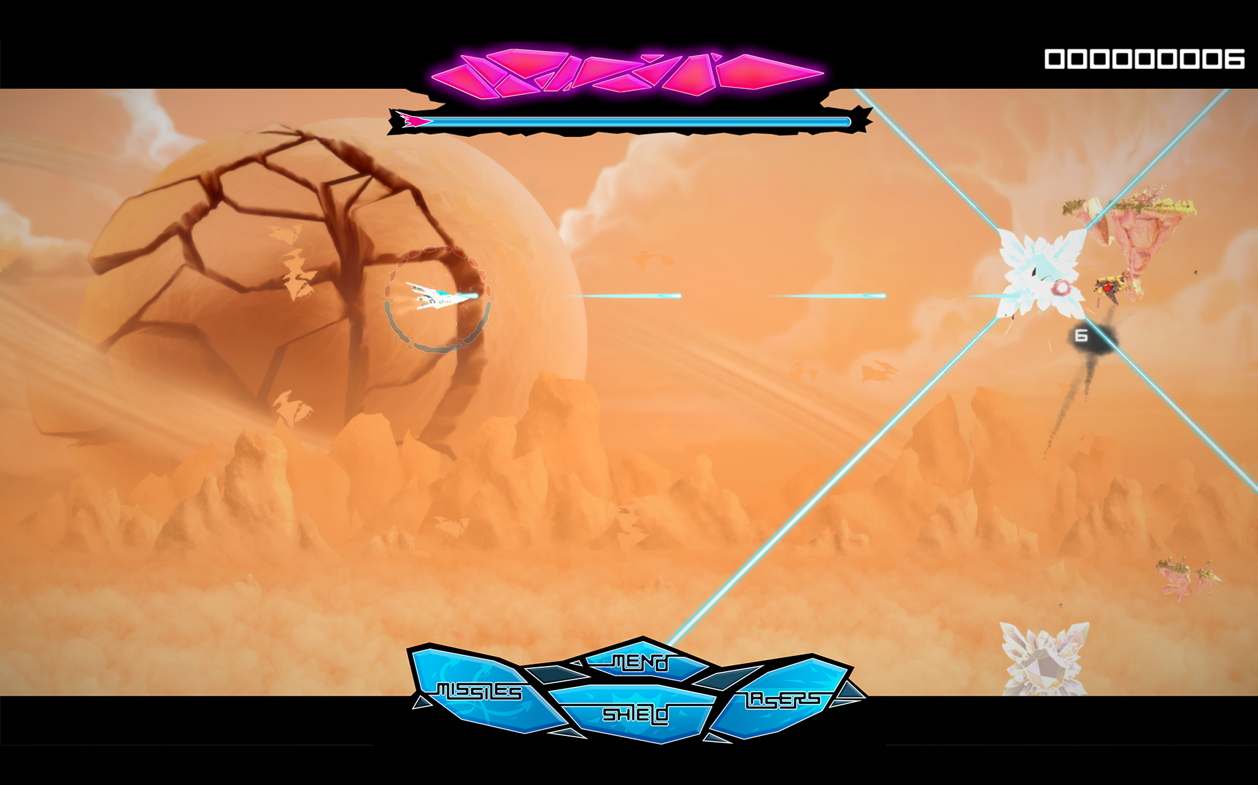
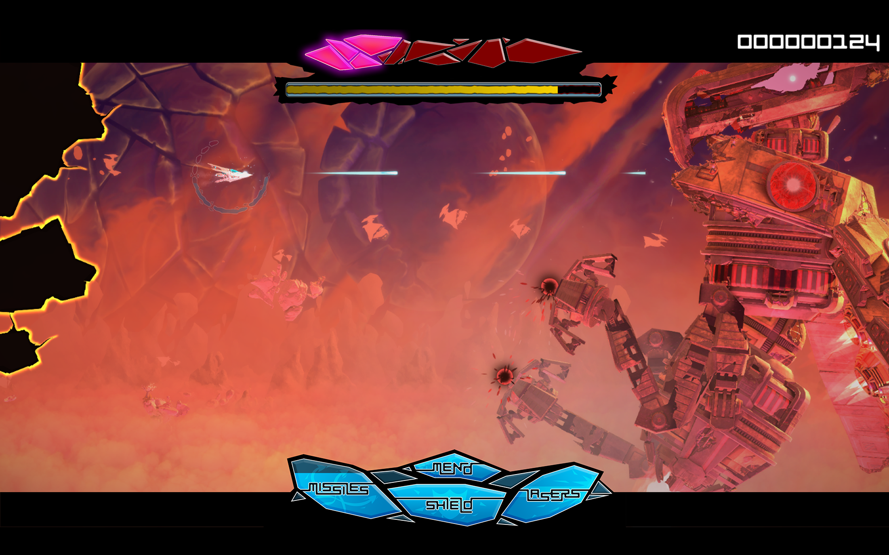

Slide 17
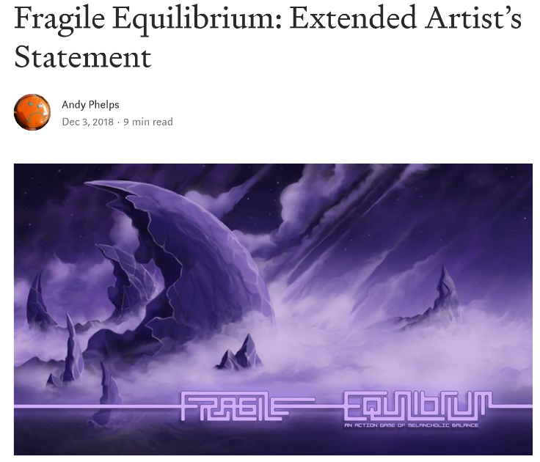
This whole game is a metaphor for living and coping with depression and anxiety.
It is intended not as an educational game, but as an experiential game.
The idea is to simply convey a feeling – the idea of compression, of balance, of a constant need to evaluate and course correct in the midst of other action and experience

Slide 18
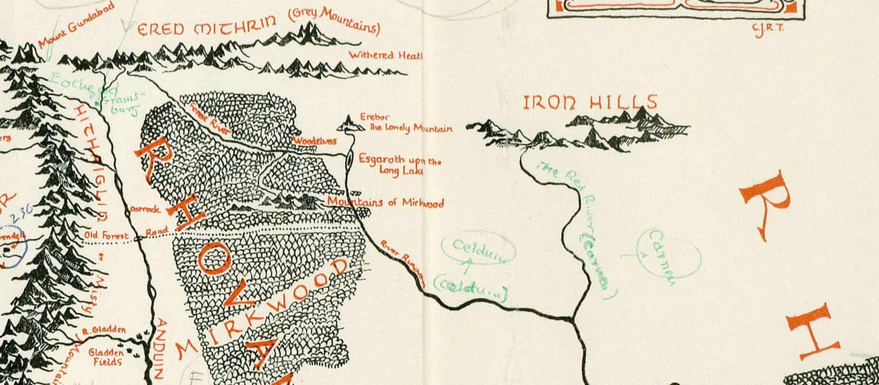
AS HUMANS, WE BRING OURSELVES TO OUR EXPERIENCES
KNOWLEDGE OF A SYSTEM IS NOT EMPATHY
AND DOES NOT PRESUPPOSE TRANSFORMATION
A large part of games’ transformative potential thus remains either unrealized or invisible (Paolo Pedercini, 2014). But how can we intentionally design for personal transformation without pre-determining the kind of change the game should ignite or seeks to impose upon its players? How can we facilitate profound, organic inner shifts through our designs that allow players to “respond to them of themselves, with recognition, uncoerced[?]” (Campbell 1991).
GAMES ARE NOT JUST COMPLEX SYSTEMS | MECHANICS

Slide 19
DESIGN SPACE MAP Mapping a design space for games of the soul
(Rusch & Phelps, DiGRA 2020, FROG 2021)

Slide 20
Notes:
Journey – https://thatgamecompany.com/journey/

Slide 21
Notes:
Walden: A Game by Tracy Fullerton and company

Slide 22
Notes:
Spiritfarer by Thunder Lotus Games: https://thunderlotusgames.com/spiritfarer/

Slide 23
https://andrewphelps.itch.io/the-witchs-way
Notes:
https://andrewphelps.itch.io/the-witchs-way

Slide 24
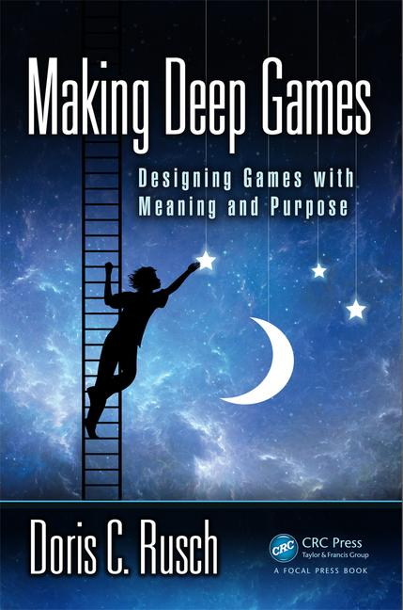
Phelps, A., Wagner, J. and Moger, A. "Experiential Depression and Anxiety Through Proceduralized Play: A Case Study of Fragile Equilibrium." (2020) Journal of Games, Self, & Society, vol. 2, no. 1. Eds. Rivers, S. E., & Dunlap, K. https://doi.org/10.1184/R1/12215417
Rusch, D. ”Existential, Transformative Game Design." (2020) Journal of Games, Self, & Society, vol. 2, no. 1. Eds. Rivers, S. E., & Dunlap, K. https://doi.org/10.1184/R1/12215417
Rusch, D. and Phelps, A. “Existential Transformational Game Design: Harnessing the "Psychomagic" of Symbolic Enactment” Frontiers in Psychology. Special Issue on Digital Games and Mental Health. doi: 10.3389/fpsyg.2020.571522 (in press)
Phelps, A., and Rusch, D. C. (2020) "Navigating Existential, Transformative Game Design." Proceedings of the Digital Games Research Association (DiGRA) 2020 Conference: Play Anywhere. Tampere, Finland. http://www.digra.org/wp-content/uploads/digital-library/DiGRA_2020_paper_21.pdf
Wagner, J., Moger, D., Consalvo, M., and Phelps, A. "Helping Grandma Home: Spiritfarer’s Progressive Treatment of Older Adults During COVID-19" Well Played: A Special Issue on the Pandemic. ETC Press, Carnegie-Mellon University. (forthcoming)
Rusch, D.C. and Phelps, A. (2021) "The Witch’s Way: A Transformational Story Adventure: Theorizing a Model for Existential, Transformative Game Design via the Creation and Analysis of an Experimental Sample Work." Foundations of Digital Games 2021 Conference (FDG21). Games & Demos. (forthcoming)
Rusch, D.C. and Phelps, A. (2021) "Games of the Soul." Proceedings of the 14th Vienna Games Conference. (forthcoming)
Games of the Soul
(2022…ish)
Rusch & Phelps
Taylor & Francis

Slide 25
CONCLUSION(ISH): WE NEED MORE AND BETTER KINDS OF ’MEANINGFUL’ GAMES
Experiential games have a unique place in the design space
By focusing less on procedural rhetoric and more on abstract expression via interaction to trigger transformation, we open different doors in the interaction of humans and technology
Utilizing these different lenses examines UX not through functionality or optimization, but through intuition and interpretation
Measuring differently to allow for different design spaces and methodologies is critical if we want to aspire to different results

Slide 26
ANDYWORLD.IO | PROFESSORANDREWPHELPS.NET | @ANDYMPHELPS | ANDYMPHELPS@GMAIL.COM
Thanks & Questions

